Slide 1
Unit 5
Operating system

Slide 2
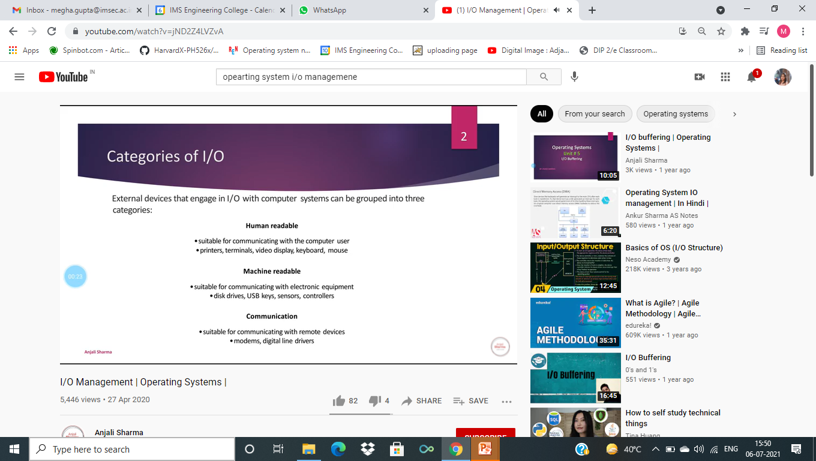

Slide 3
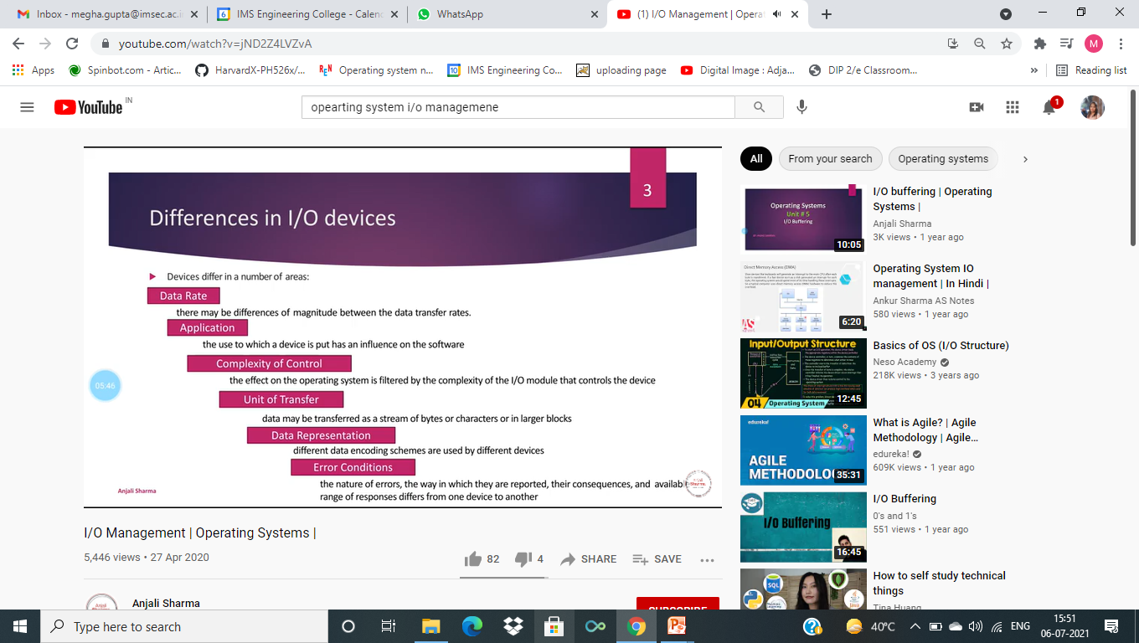

Slide 4
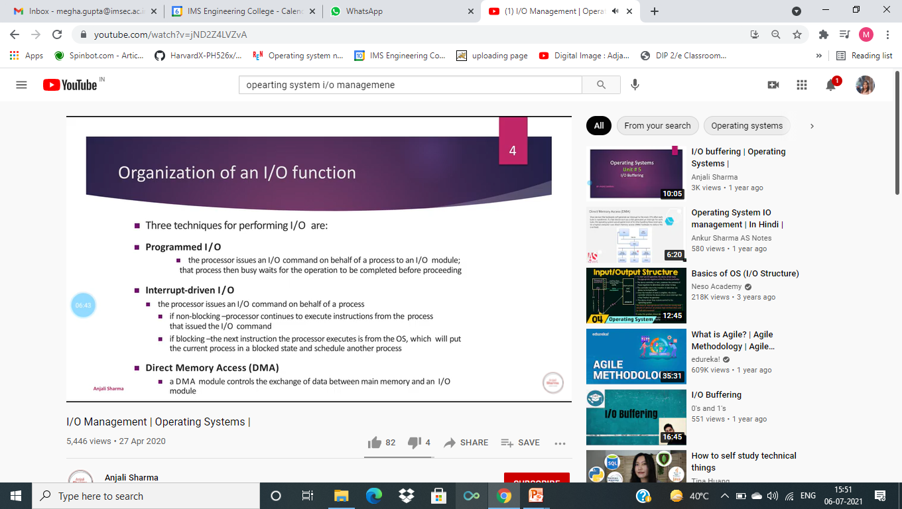

Slide 5
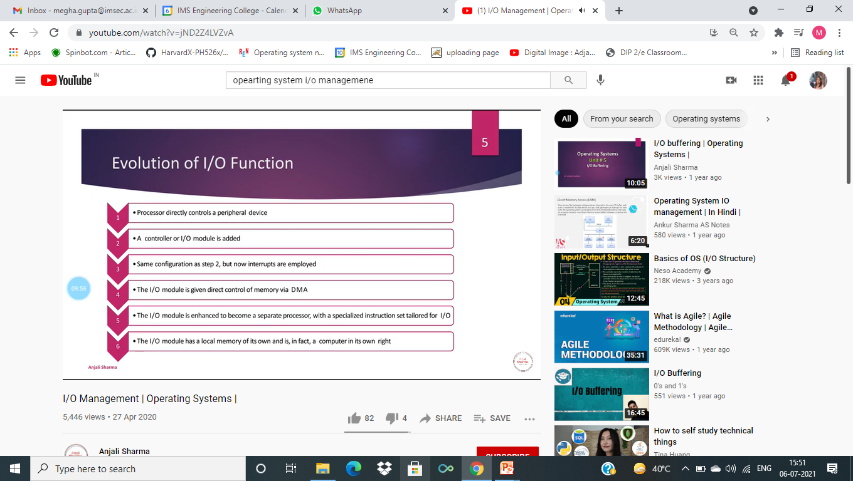

Slide 6
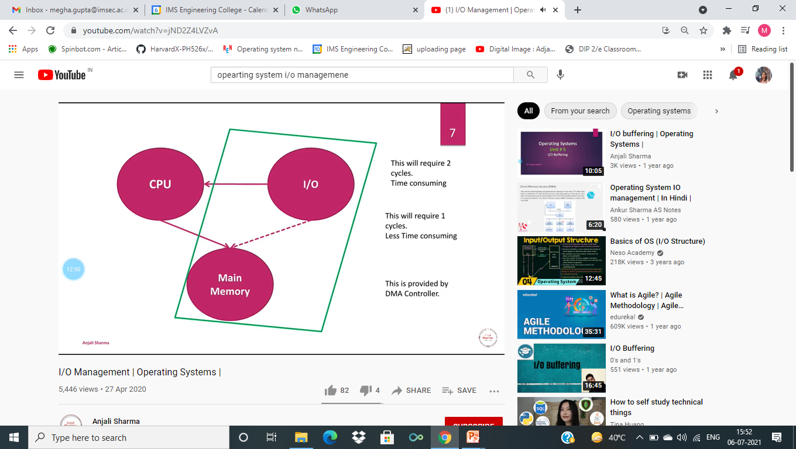

Slide 7


Slide 8


Slide 9


Slide 10
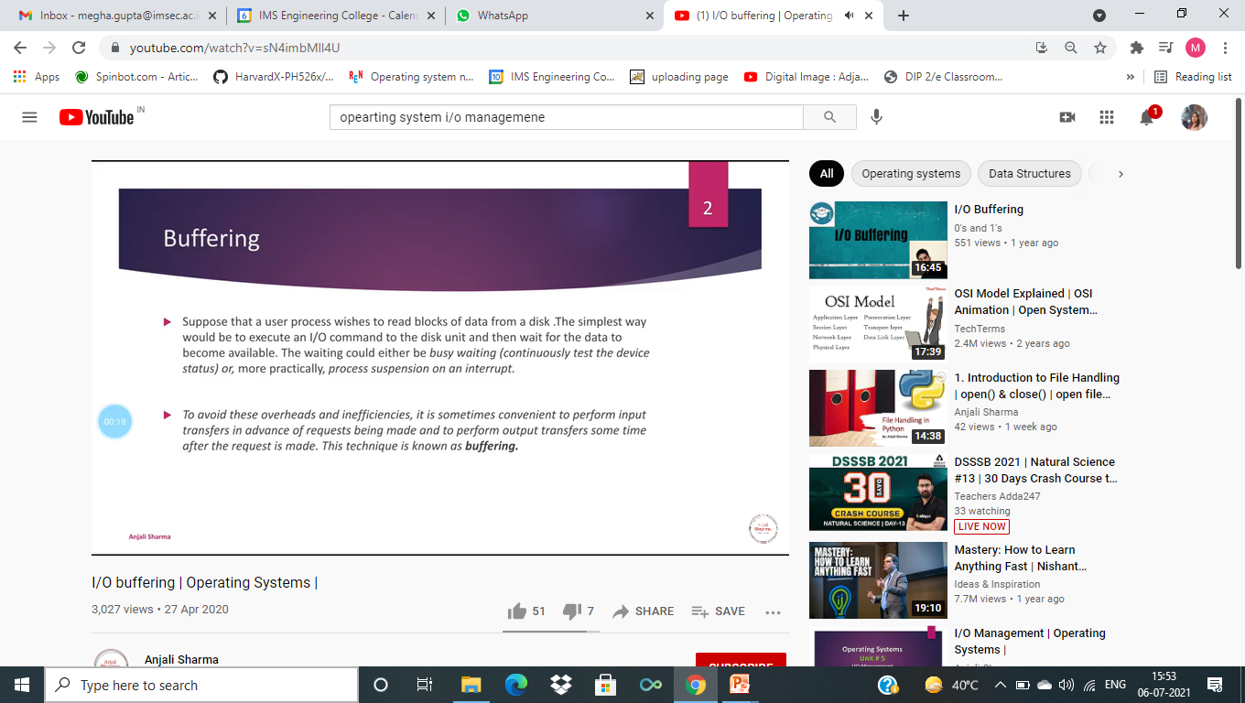

Slide 11
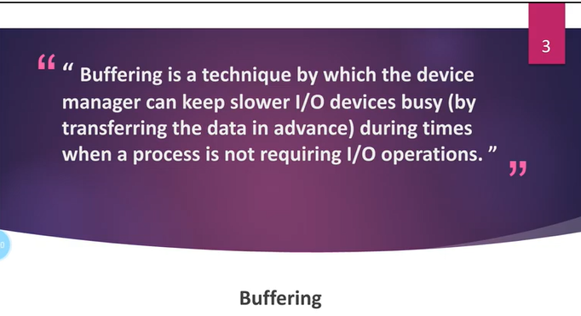

Slide 12


Slide 13


Slide 14


Slide 15
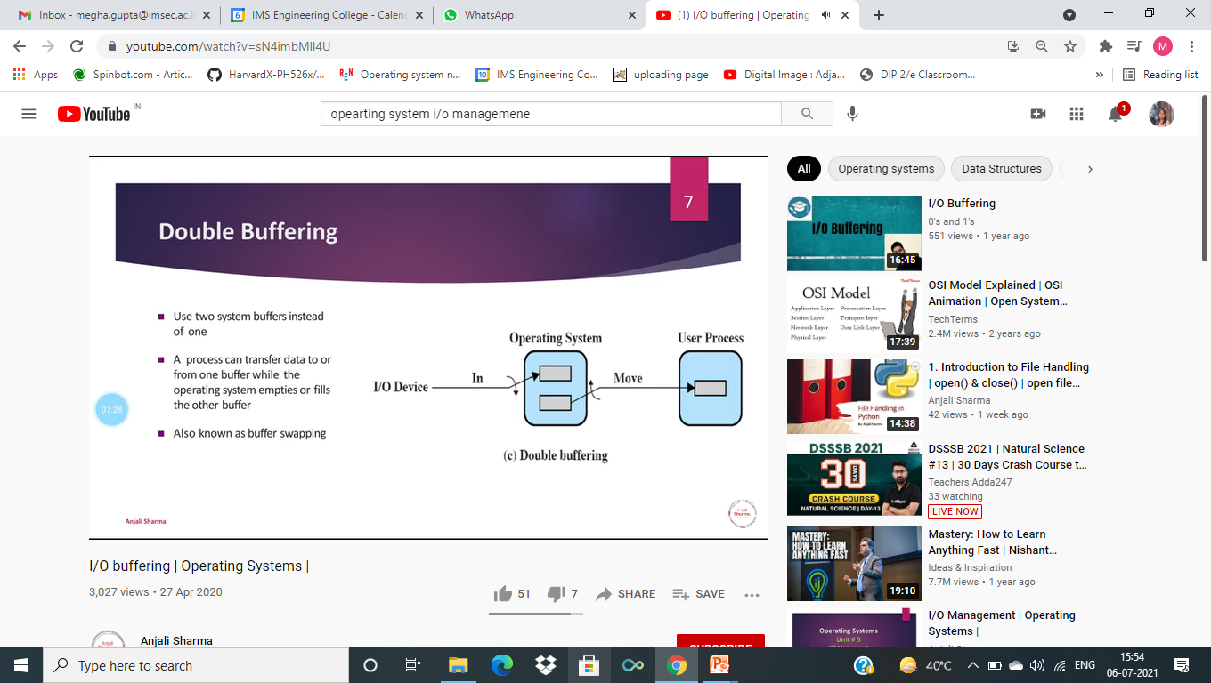

Slide 16


Slide 17
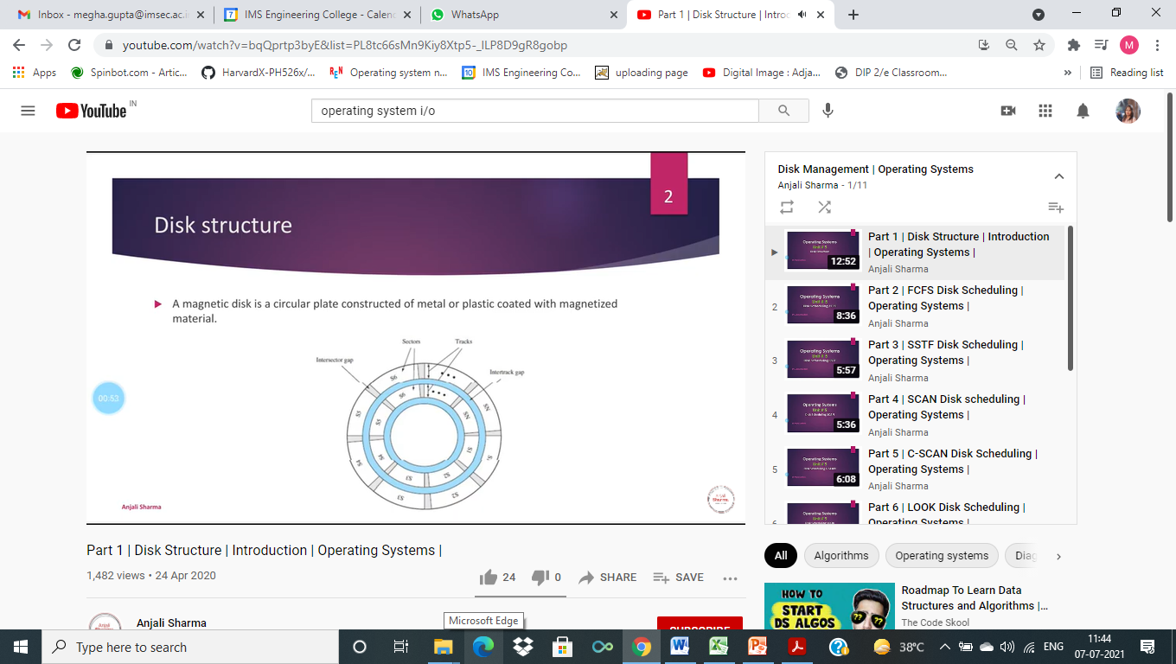

Slide 18
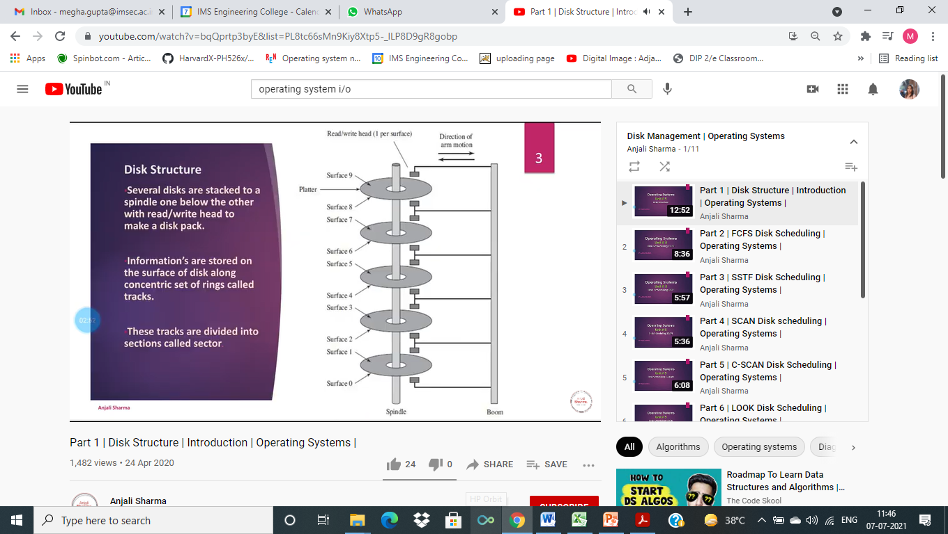

Slide 19
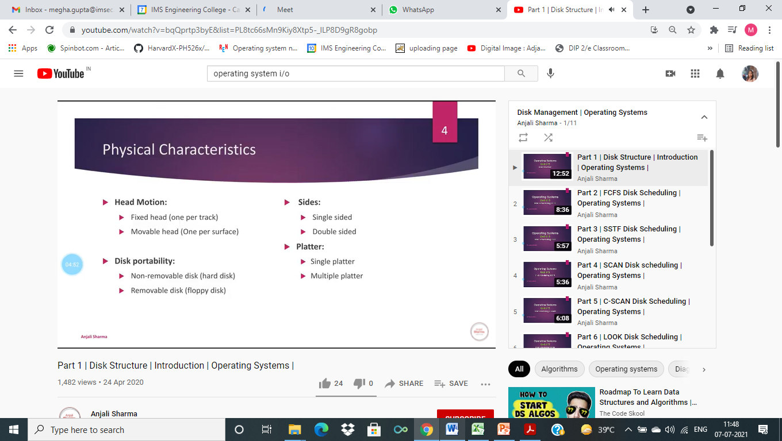

Slide 20
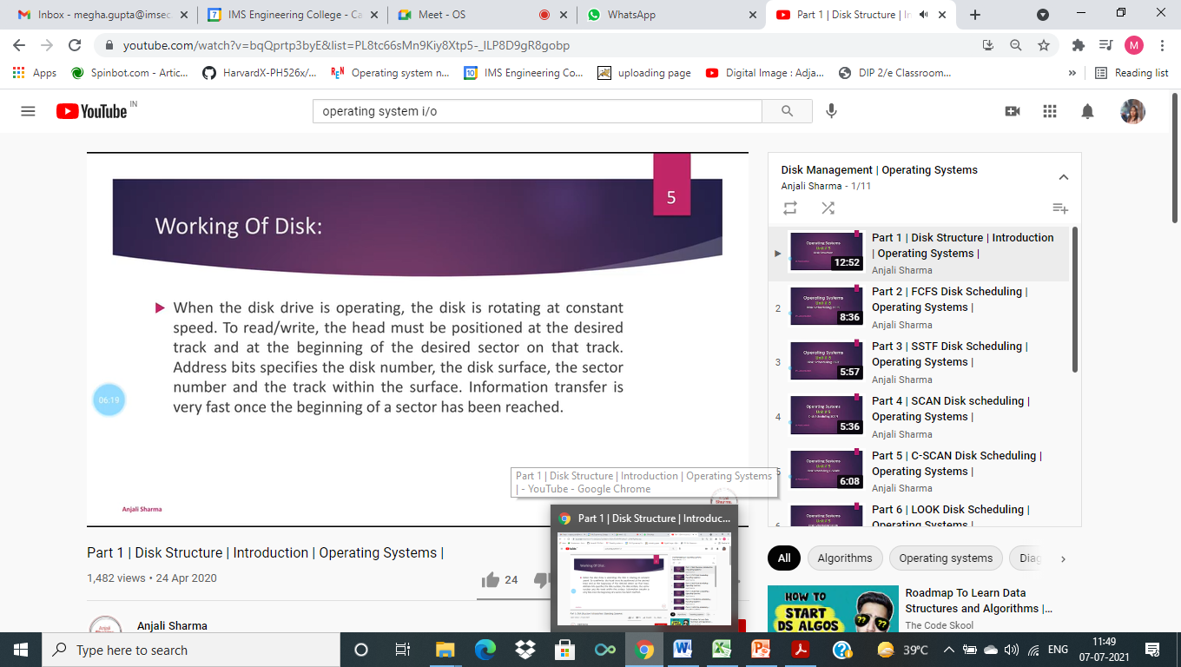

Slide 21
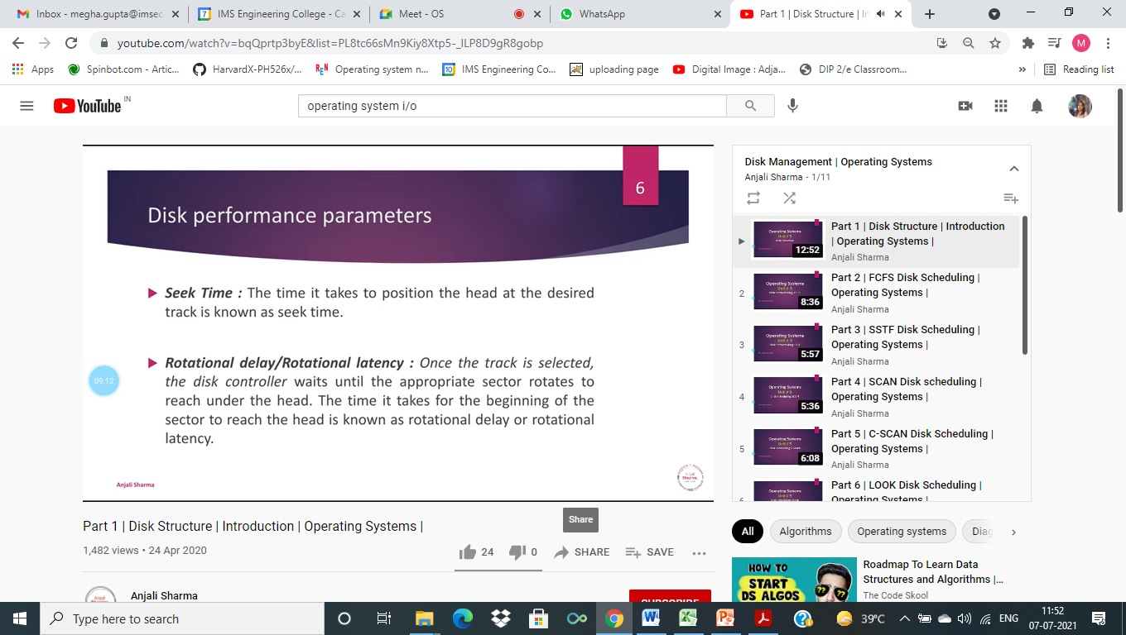

Slide 22


Slide 23
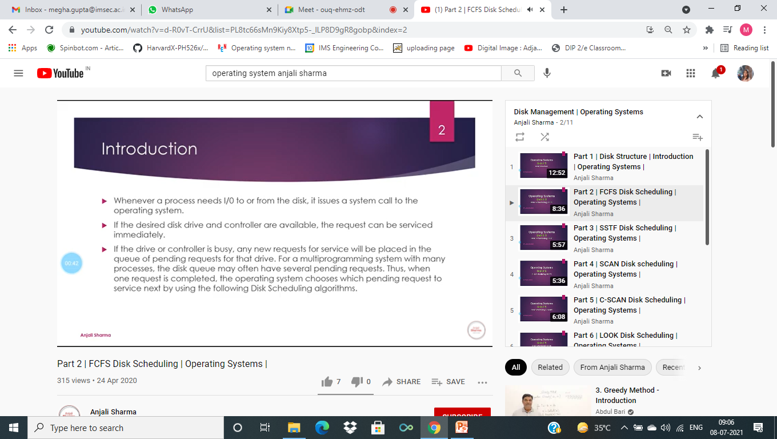

Slide 24
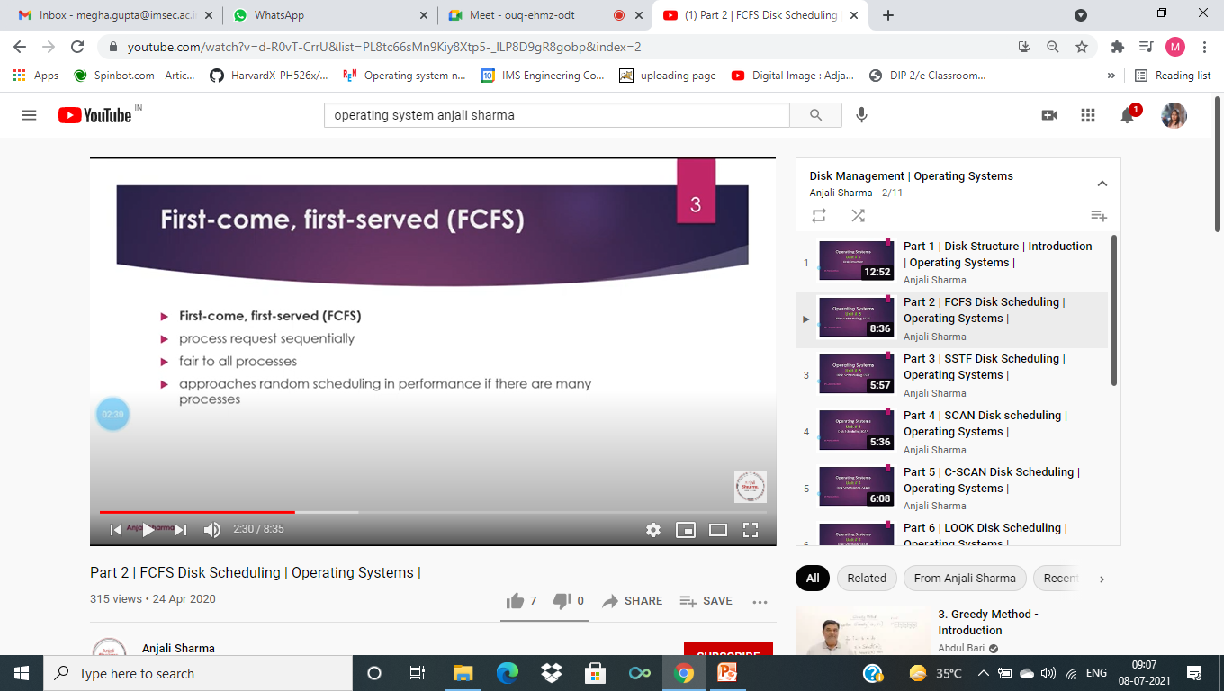

Slide 25
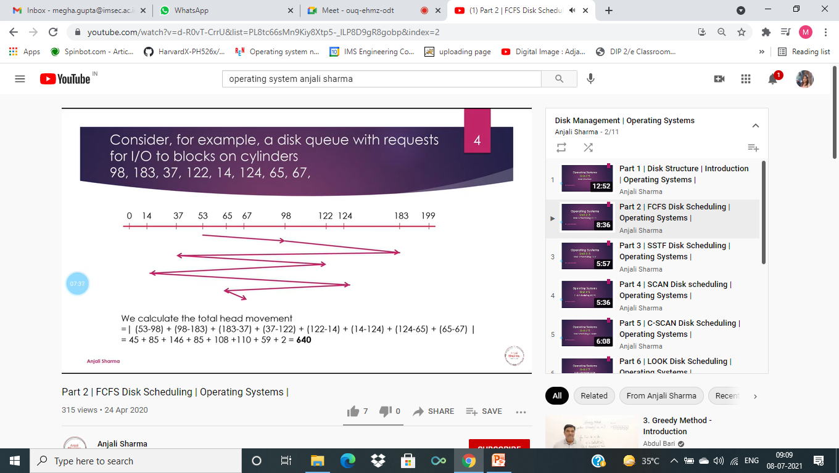

Slide 26
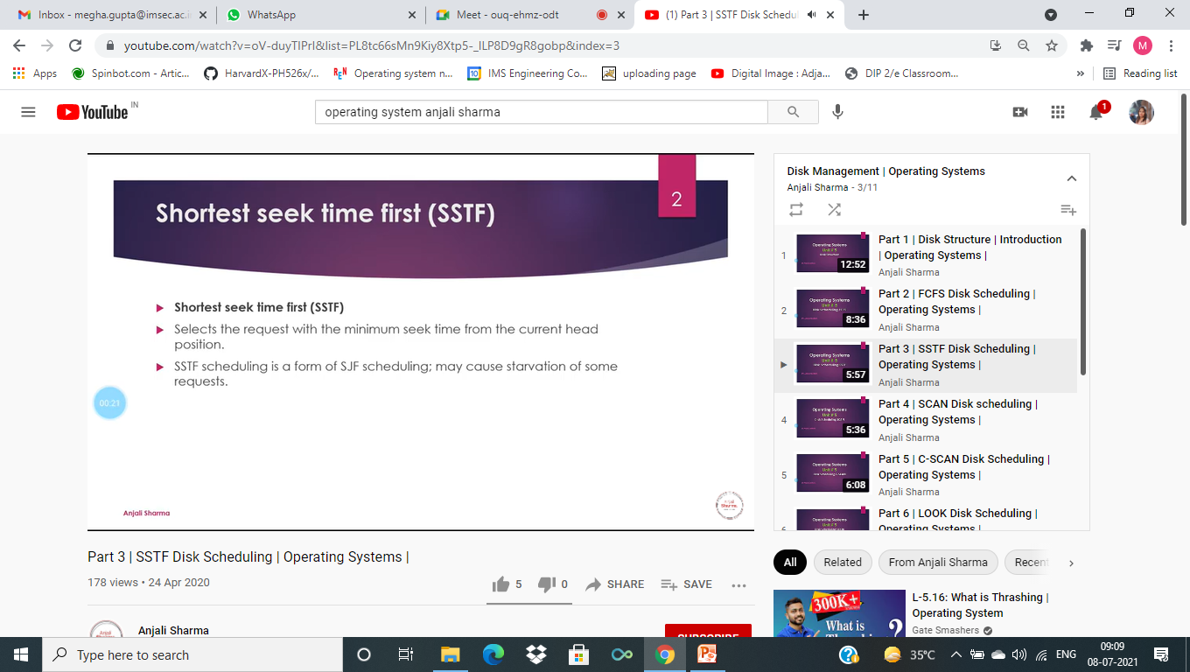

Slide 27


Slide 28
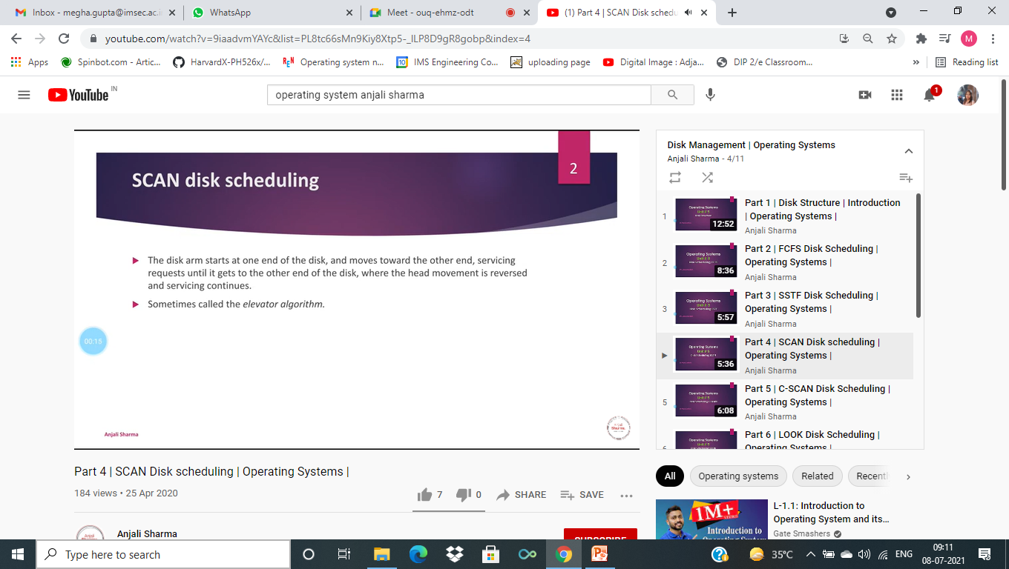

Slide 29
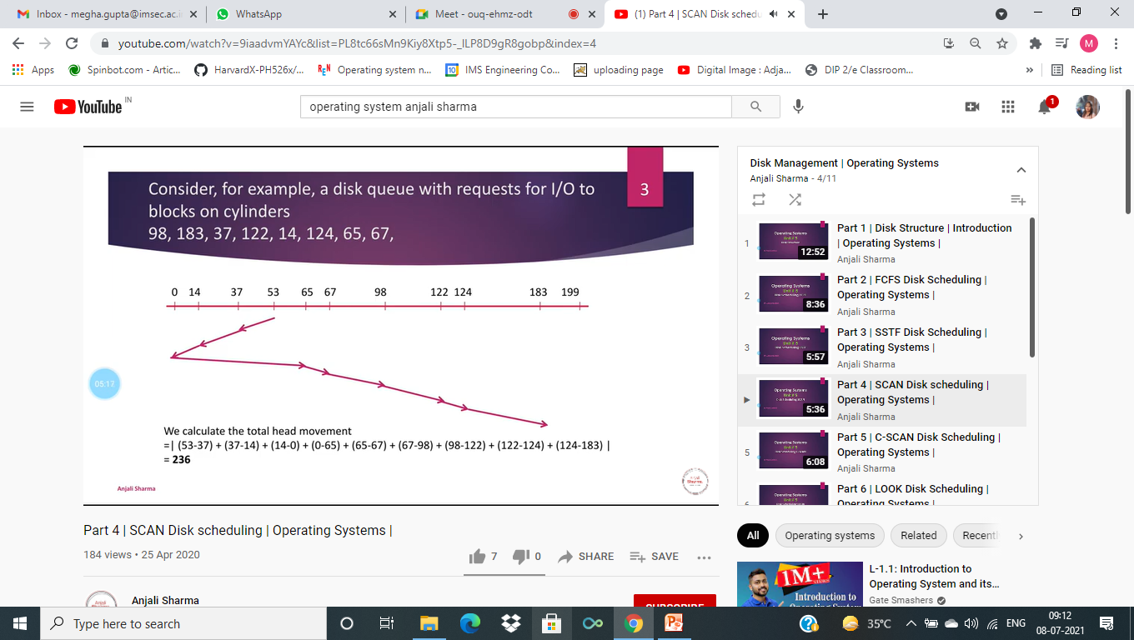

Slide 30
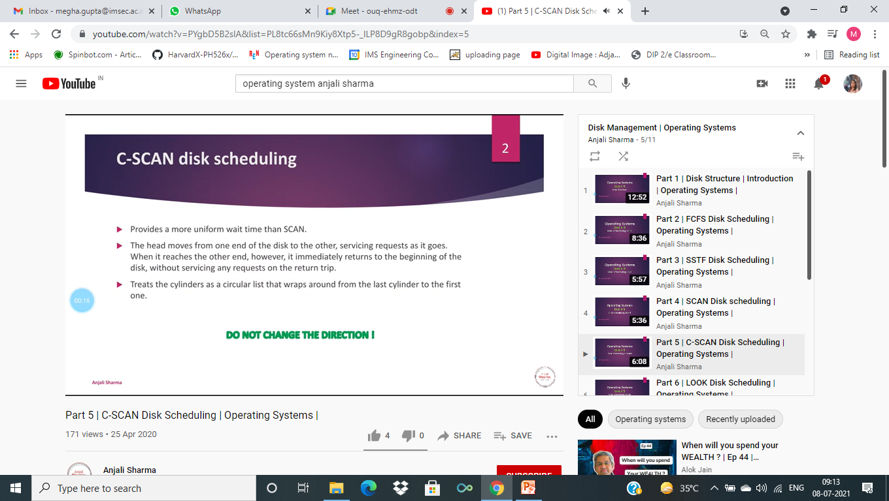

Slide 31
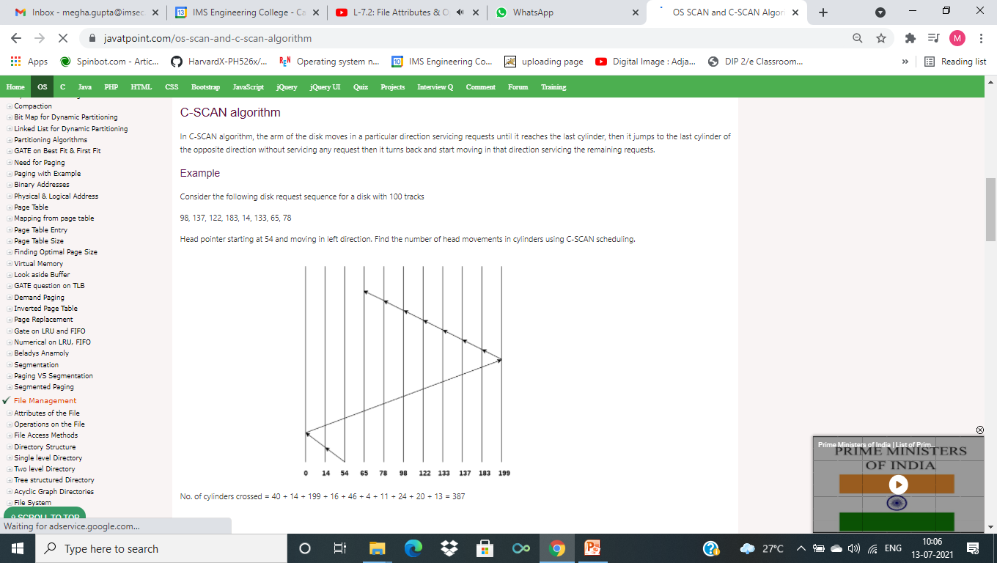

Slide 32
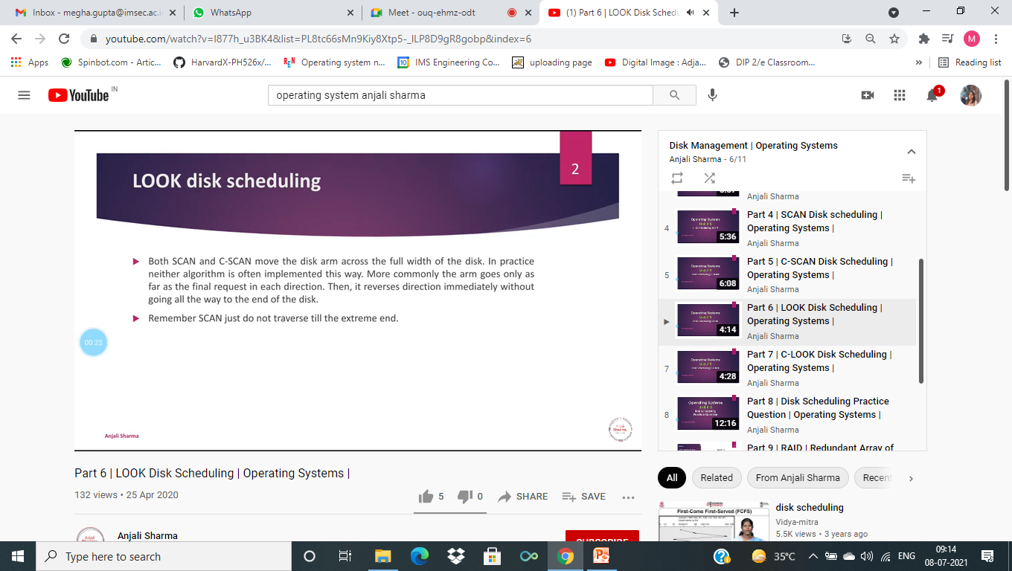

Slide 33
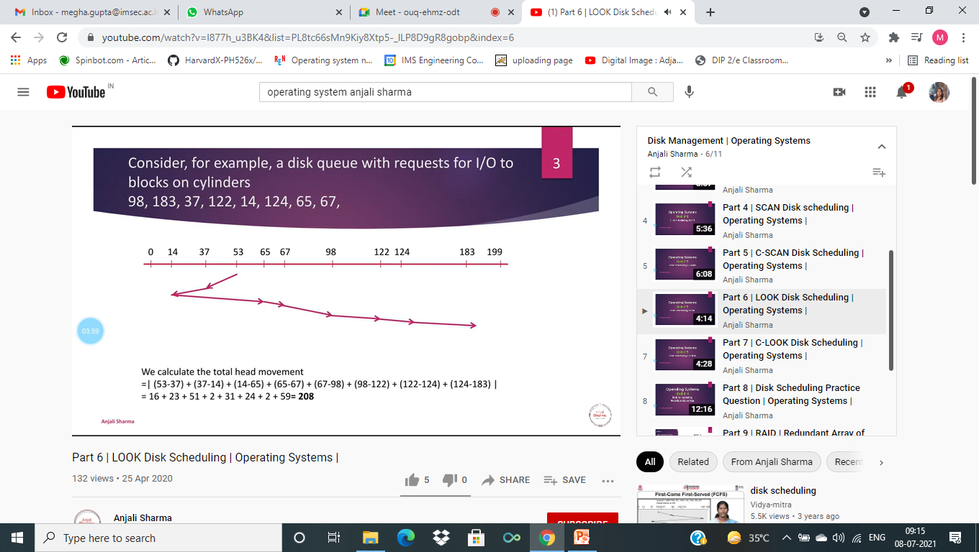

Slide 34
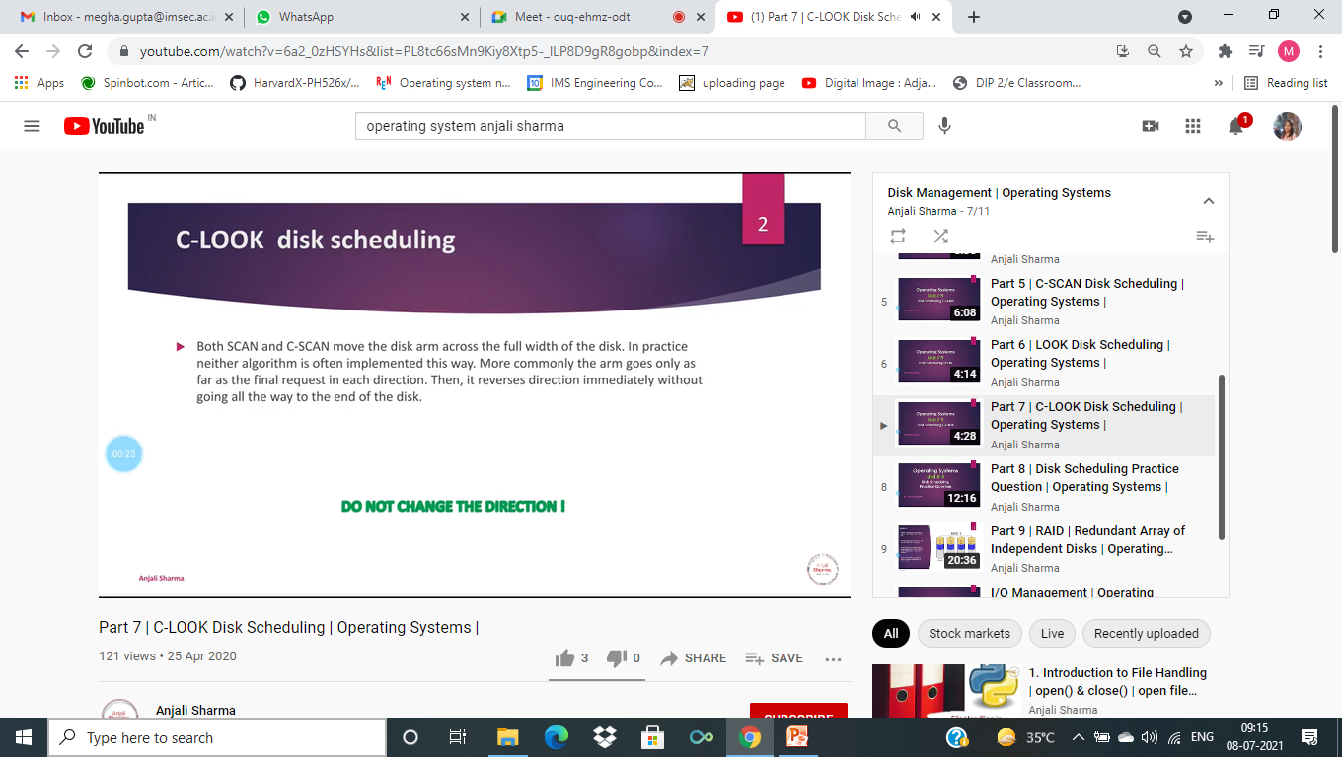

Slide 35
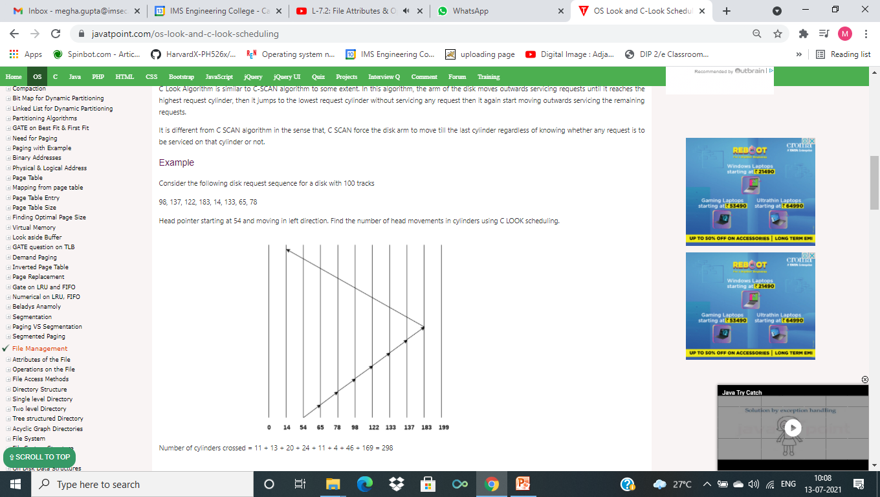

Slide 36


Slide 37
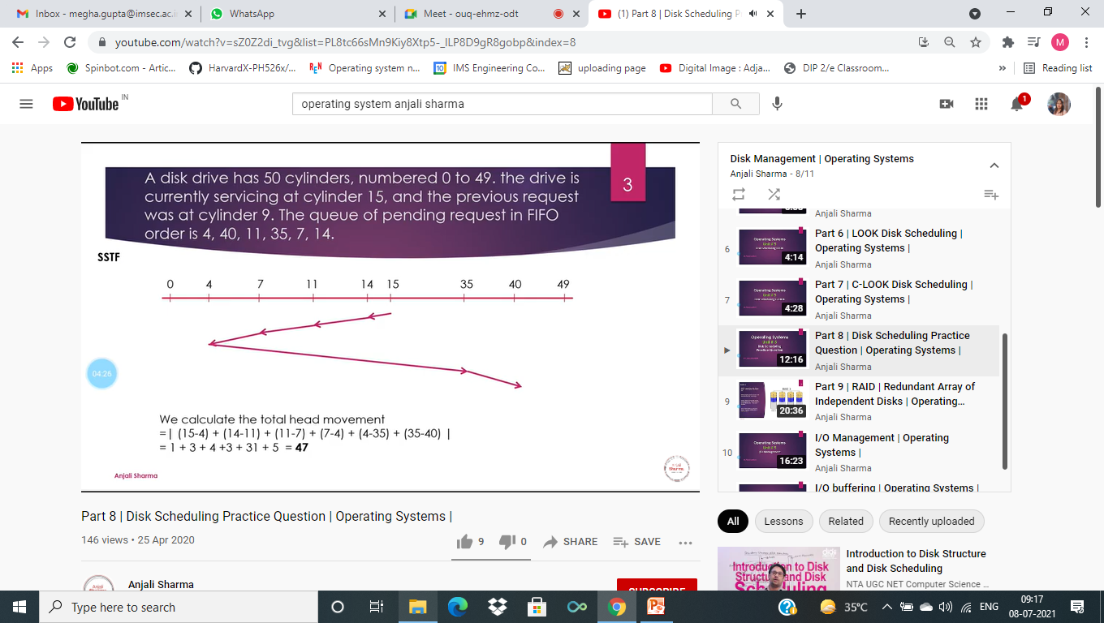

Slide 38
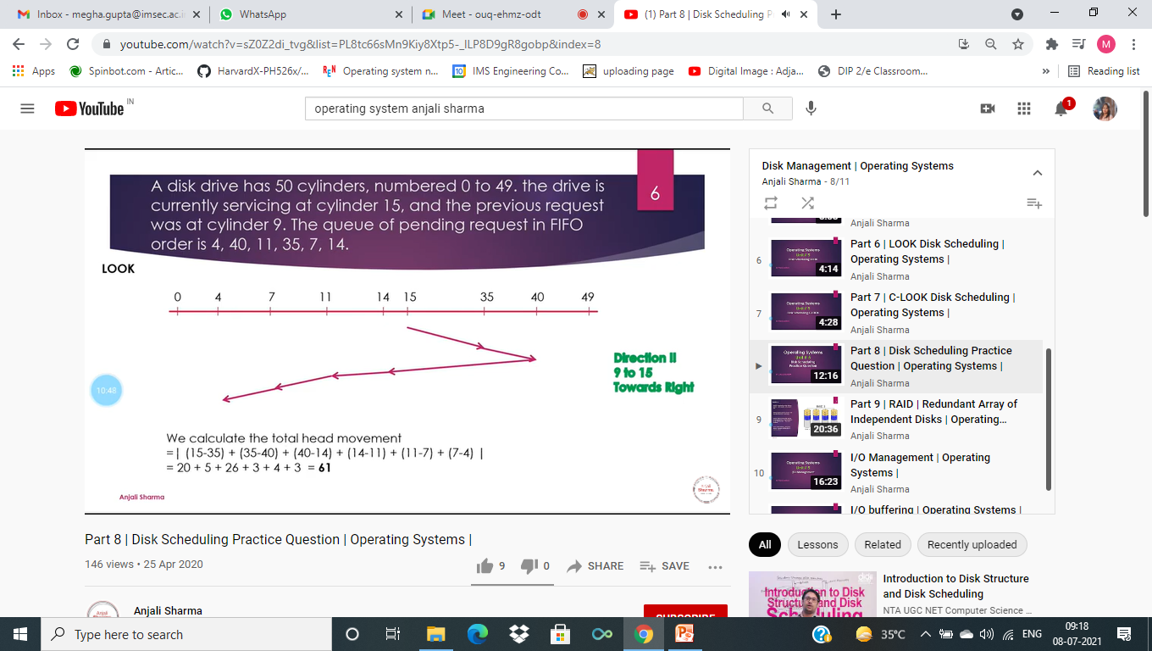

Slide 39
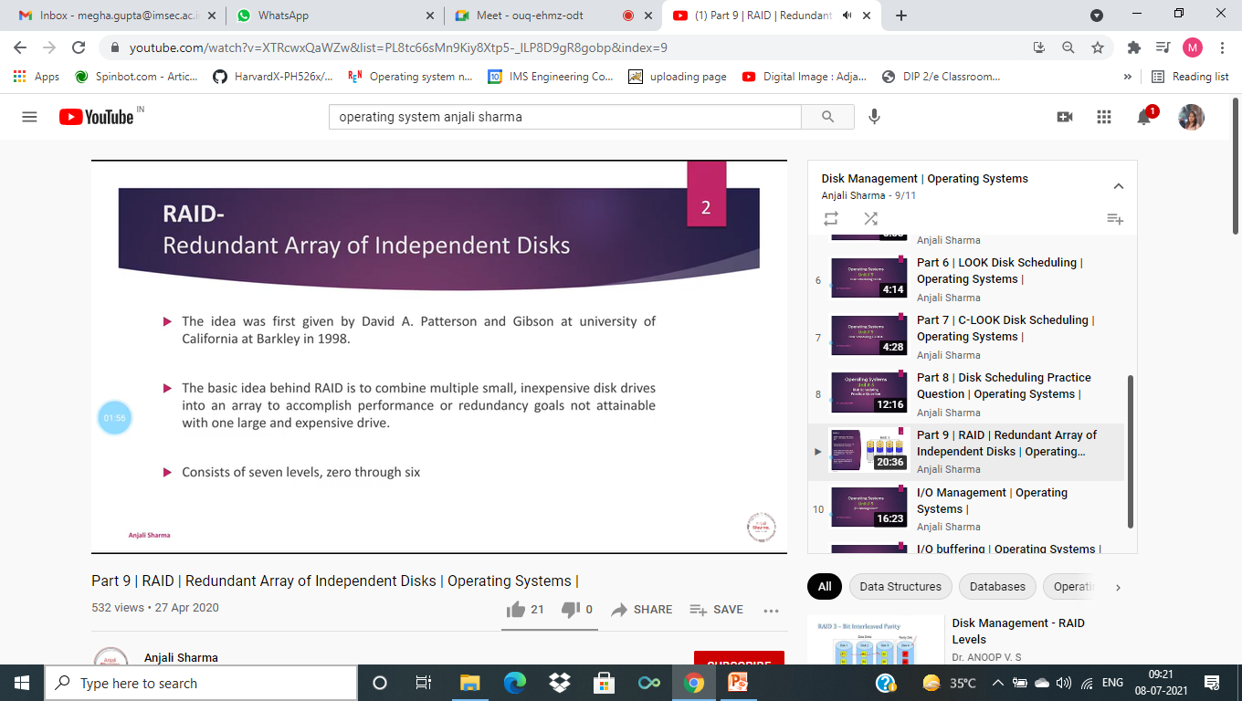

Slide 40
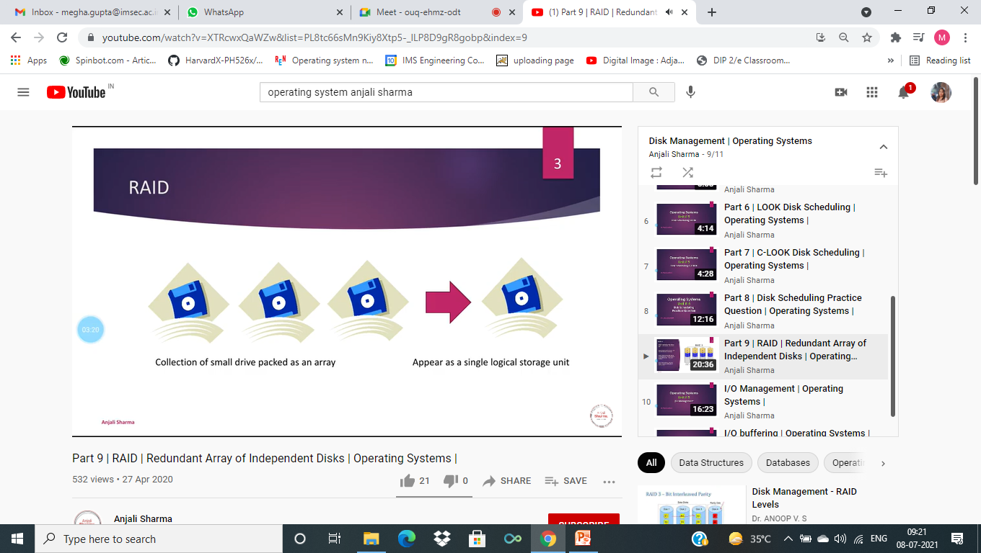

Slide 41
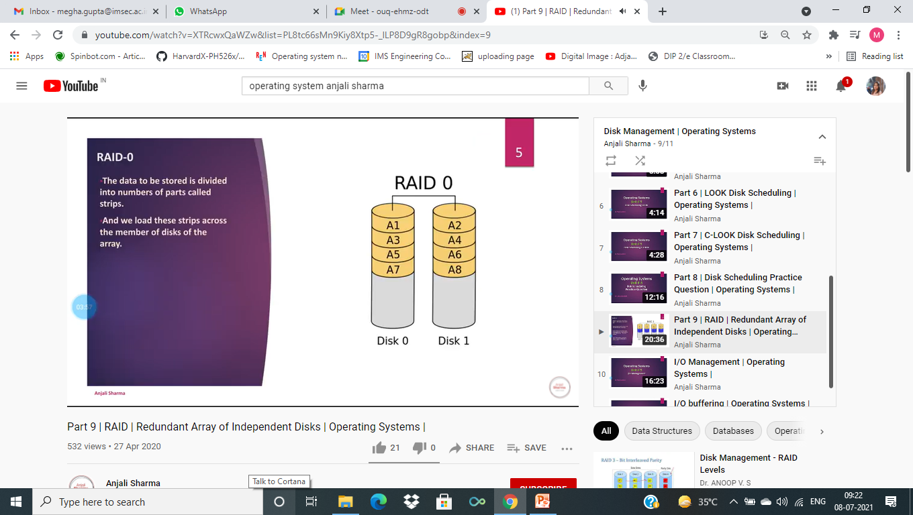

Slide 42
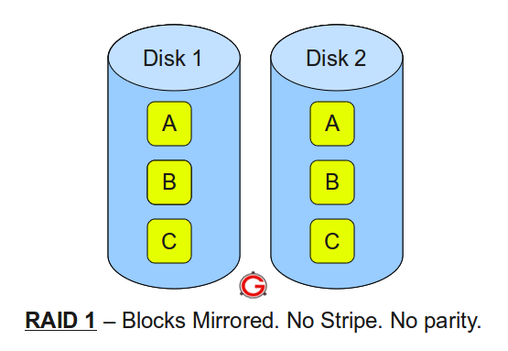
RAID 1

Slide 43
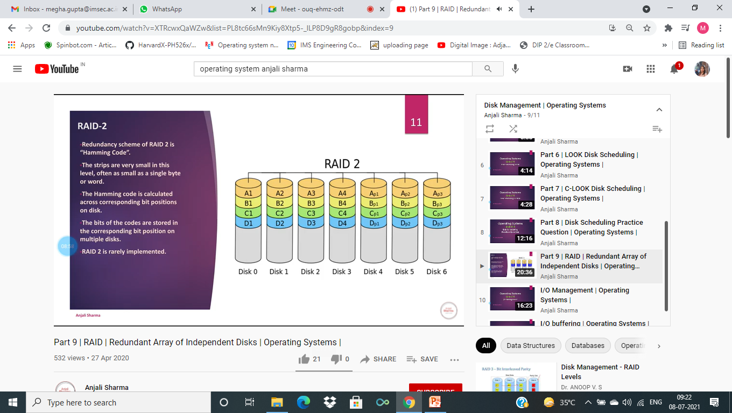

Slide 44
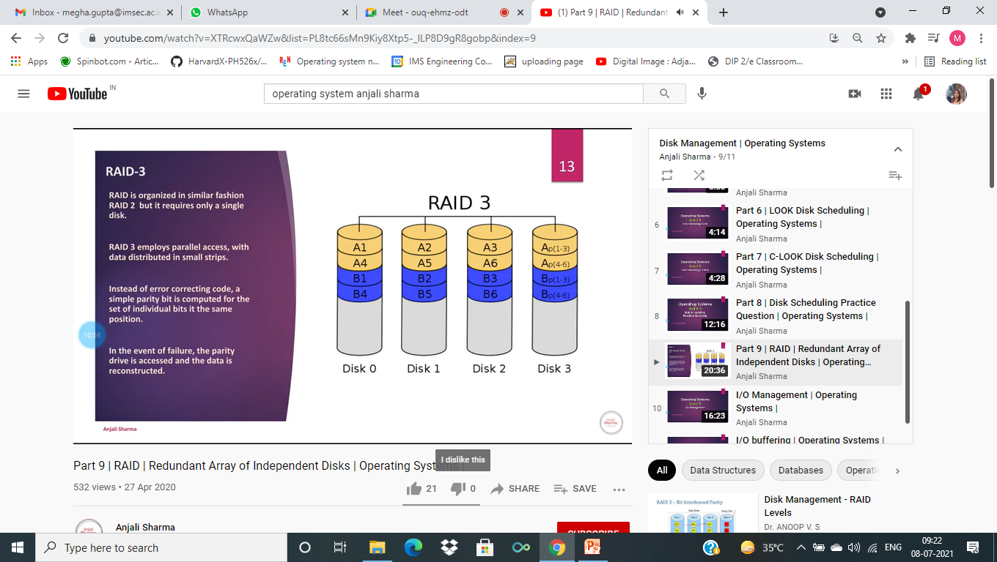

Slide 45
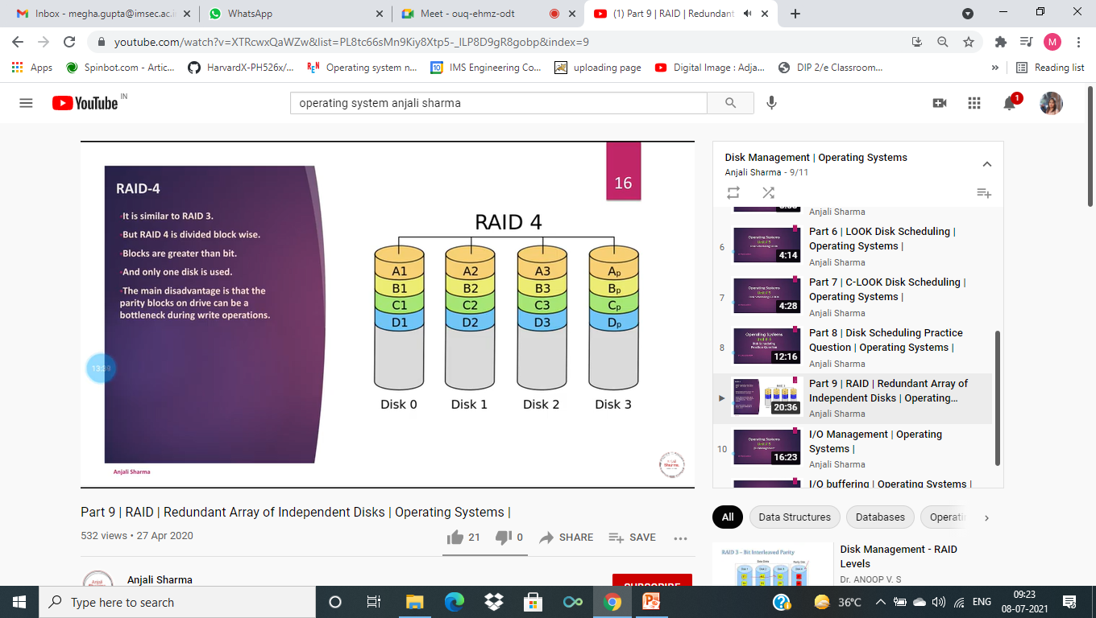

Slide 46
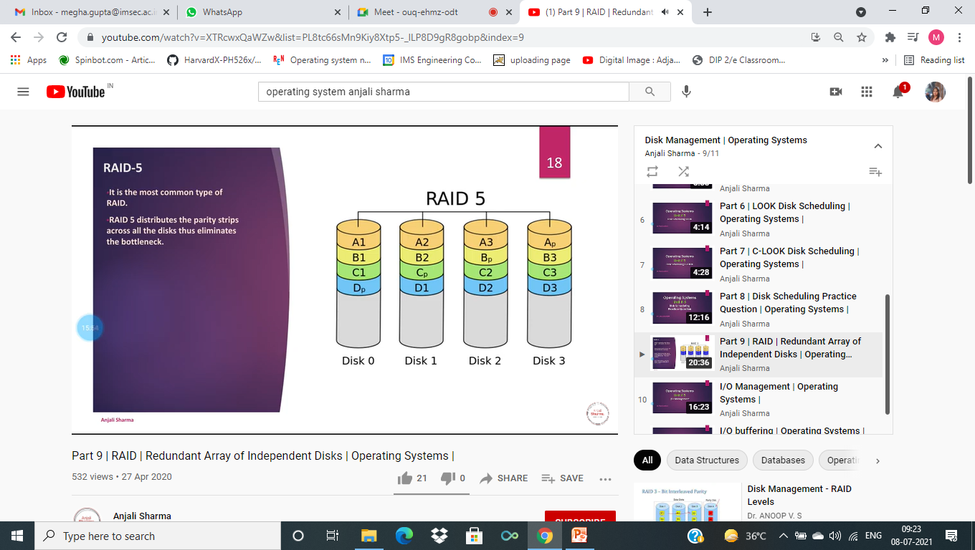

Slide 47
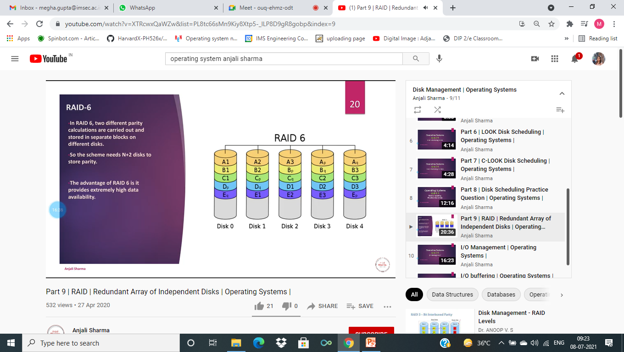

Slide 48
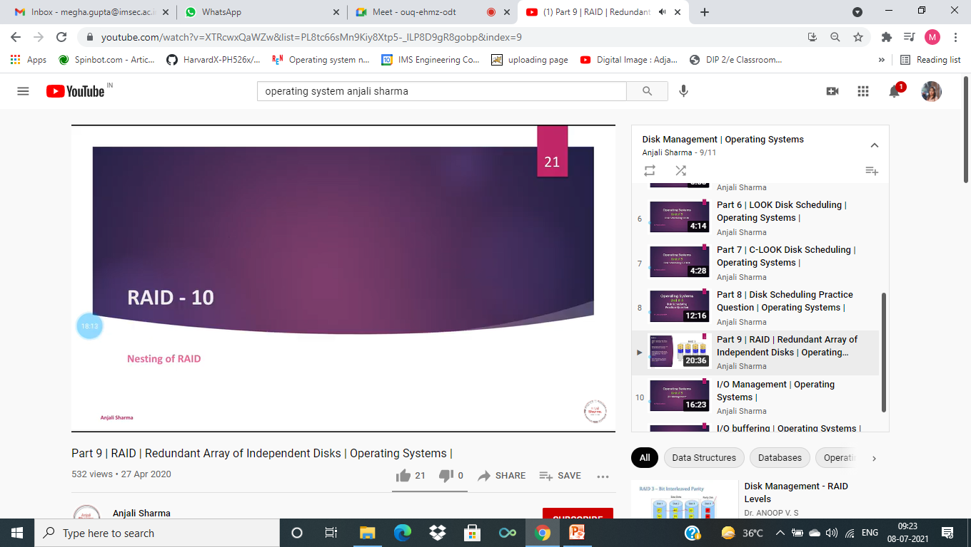

Slide 49
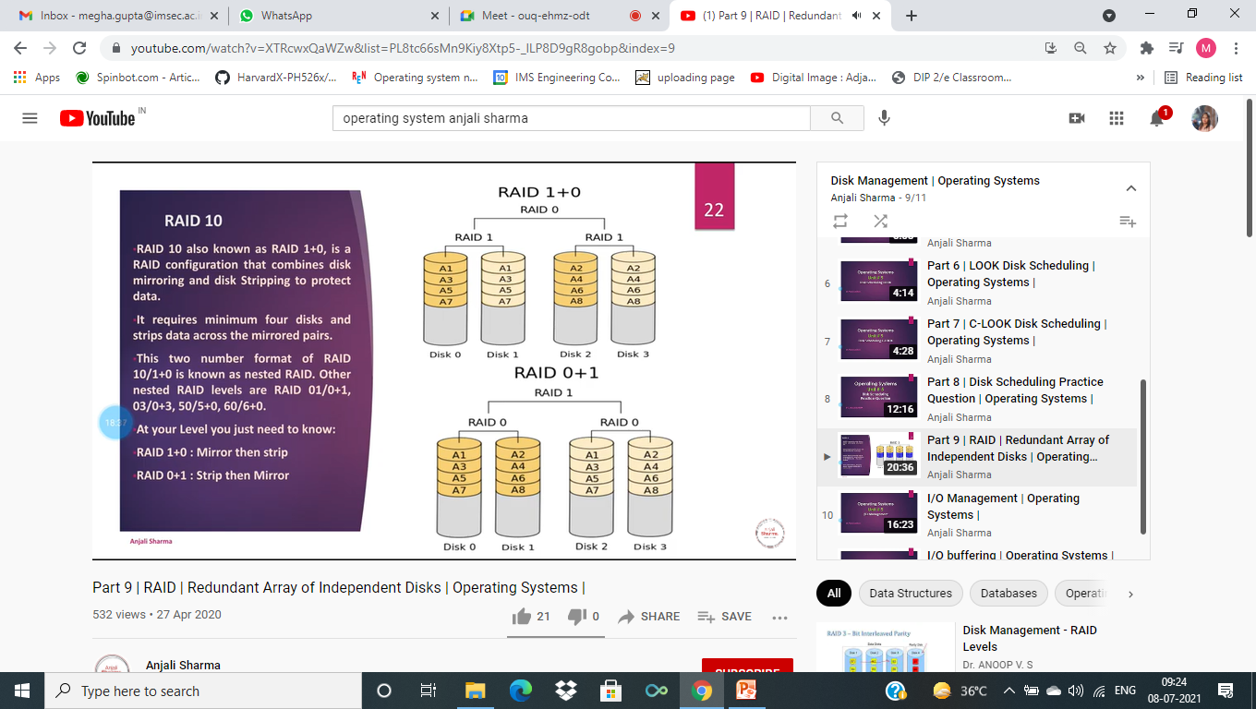

Slide 50

What is a File ?
A file can be defined as a data structure which stores the sequence of records. Files are stored in a file system, which may exist on a disk or in the main memory. Files can be simple (plain text) or complex (specially-formatted).
The collection of files is known as Directory. The collection of directories at the different levels, is known as File System.

Slide 51
Attributes of the File
1.Name
Every file carries a name by which the file is recognized in the file system. One directory cannot have two files with the same name.
2.Identifier
Along with the name, Each File has its own extension which identifies the type of the file. For example, a text file has the extension .txt, A video file can have the extension .mp4.
3.Type
In a File System, the Files are classified in different types such as video files, audio files, text files, executable files, etc.
4.Location
In the File System, there are several locations on which, the files can be stored. Each file carries its location as its attribute.
5.Size
The Size of the File is one of its most important attribute. By size of the file, we mean the number of bytes acquired by the file in the memory.
6.Protection
The Admin of the computer may want the different protections for the different files. Therefore each file carries its own set of permissions to the different group of Users.
7.Time and Date
Every file carries a time stamp which contains the time and date on which the file is last modified.

Slide 52
Operations on the File
There are various operations which can be implemented on a file. We will see all of them in detail.
1.Create
Creation of the file is the most important operation on the file. Different types of files are created by different methods for example text editors are used to create a text file, word processors are used to create a word file and Image editors are used to create the image files.

Slide 53
2.Write
Writing the file is different from creating the file. The OS maintains a write pointer for every file which points to the position in the file from which, the data needs to be written.
3.Read
Every file is opened in three different modes : Read, Write and append. A Read pointer is maintained by the OS, pointing to the position up to which, the data has been read.
4.Re-position
Re-positioning is simply moving the file pointers forward or backward depending upon the user's requirement. It is also called as seeking.
5.Delete
Deleting the file will not only delete all the data stored inside the file, It also deletes all the attributes of the file. The space which is allocated to the file will now become available and can be allocated to the other files.
6.Truncate
Truncating is simply deleting the file except deleting attributes. The file is not completely deleted although the information stored inside the file get replaced.

Slide 54
File Access Methods
Let's look at various ways to access files stored in secondary memory.
Sequential access
Direct access
Indexed Access

Slide 55
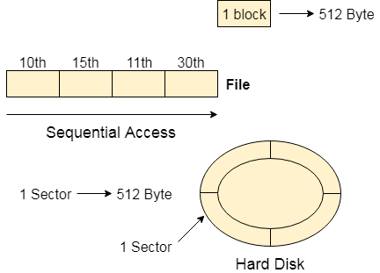
Sequential Access

Slide 56
Most of the operating systems access the file sequentially. In other words, we can say that most of the files need to be accessed sequentially by the operating system.
In sequential access, the OS read the file word by word. A pointer is maintained which initially points to the base address of the file. If the user wants to read first word of the file then the pointer provides that word to the user and increases its value by 1 word. This process continues till the end of the file.
Modern word systems do provide the concept of direct access and indexed access but the most used method is sequential access due to the fact that most of the files such as text files, audio files, video files, etc need to be sequentially accessed.

Slide 57
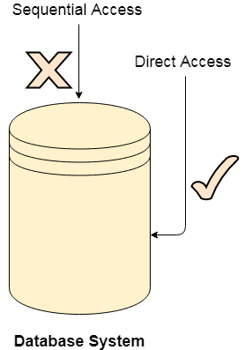
Direct Access

Slide 58
The Direct Access is mostly required in the case of database systems. In most of the cases, we need filtered information from the database. The sequential access can be very slow and inefficient in such cases.
Suppose every block of the storage stores 4 records and we know that the record we needed is stored in 10th block. In that case, the sequential access will not be implemented because it will traverse all the blocks in order to access the needed record.
Direct access will give the required result despite of the fact that the operating system has to perform some complex tasks such as determining the desired block number. However, that is generally implemented in database applications.

Slide 59
Indexed Access
If a file can be sorted on any of the filed then an index can be assigned to a group of certain records. However, A particular record can be accessed by its index. The index is nothing but the address of a record in the file.
In index accessing, searching in a large database became very quick and easy but we need to have some extra space in the memory to store the index value.

Slide 60
Directory Structure
What is a directory?
Directory can be defined as the listing of the related files on the disk. The directory may store some or the entire file attributes.
To get the benefit of different file systems on the different operating systems, A hard disk can be divided into the number of partitions of different sizes. The partitions are also called volumes or mini disks.
Each partition must have at least one directory in which, all the files of the partition can be listed. A directory entry is maintained for each file in the directory which stores all the information related to that file.

Slide 61
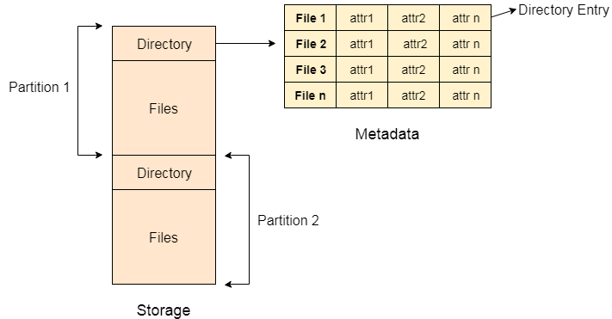

Slide 62
A directory can be viewed as a file which contains the Meta data of the bunch of files.
Every Directory supports a number of common operations on the file:
File Creation
Search for the file
File deletion
Renaming the file
Traversing Files
Listing of files

Slide 63
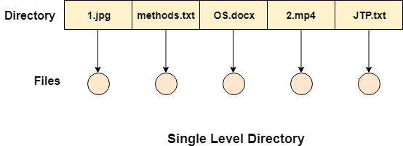
Single Level Directory
The simplest method is to have one big list of all the files on the disk. The entire system will contain only one directory which is supposed to mention all the files present in the file system. The directory contains one entry per each file present on the file system.

Slide 64
This type of directories can be used for a simple system.
Advantages
Implementation is very simple.
If the sizes of the files are very small then the searching becomes faster.
File creation, searching, deletion is very simple since we have only one directory.
Disadvantages
We cannot have two files with the same name.
The directory may be very big therefore searching for a file may take so much time.
Protection cannot be implemented for multiple users.
There are no ways to group same kind of files.
Choosing the unique name for every file is a bit complex and limits the number of files in the system because most of the Operating System limits the number of characters used to construct the file name.

Slide 65
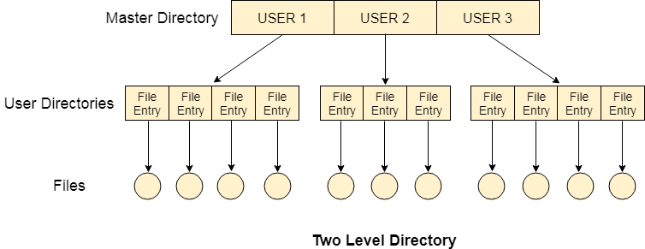
Two Level Directory
In two level directory systems, we can create a separate directory for each user. There is one master directory which contains separate directories dedicated to each user. For each user, there is a different directory present at the second level, containing group of user's file. The system doesn't let a user to enter in the other user's directory without permission.

Slide 66
Characteristics of two level directory system
Each files has a path name as /User-name/directory-name/
Different users can have the same file name.
Searching becomes more efficient as only one user's list needs to be traversed.
The same kind of files cannot be grouped into a single directory for a particular user.
Every Operating System maintains a variable as PWD which contains the present directory name (present user name) so that the searching can be done appropriately.

Slide 67
Tree Structured Directory
In Tree structured directory system, any directory entry can either be a file or sub directory. Tree structured directory system overcomes the drawbacks of two level directory system. The similar kind of files can now be grouped in one directory.
Each user has its own directory and it cannot enter in the other user's directory. However, the user has the permission to read the root's data but he cannot write or modify this. Only administrator of the system has the complete access of root directory.
Searching is more efficient in this directory structure. The concept of current working directory is used. A file can be accessed by two types of path, either relative or absolute.
Absolute path is the path of the file with respect to the root directory of the system while relative path is the path with respect to the current working directory of the system. In tree structured directory systems, the user is given the privilege to create the files as well as directories.

Slide 68
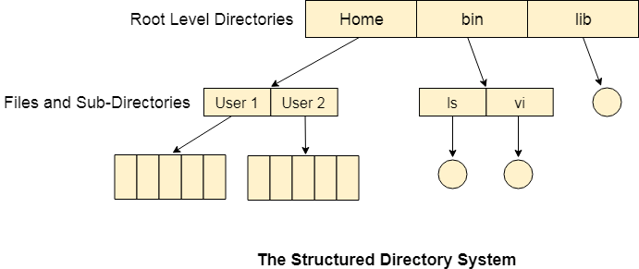

Slide 69
Permissions on the file and directory
A tree structured directory system may consist of various levels therefore there is a set of permissions assigned to each file and directory.
The permissions are R W X which are regarding reading, writing and the execution of the files or directory. The permissions are assigned to three types of users: owner, group and others.
There is a identification bit which differentiate between directory and file. For a directory, it is d and for a file, it is dot (.)
The following snapshot shows the permissions assigned to a file in a Linux based system. Initial bit d represents that it is a directory.

Slide 70
Acyclic-Graph Structured Directories
The tree structured directory system doesn't allow the same file to exist in multiple directories therefore sharing is major concern in tree structured directory system. We can provide sharing by making the directory an acyclic graph. In this system, two or more directory entry can point to the same file or sub directory. That file or sub directory is shared between the two directory entries.
These kinds of directory graphs can be made using links or aliases. We can have multiple paths for a same file. Links can either be symbolic (logical) or hard link (physical).
If a file gets deleted in acyclic graph structured directory system, then
1. In the case of soft link, the file just gets deleted and we are left with a dangling pointer.
2. In the case of hard link, the actual file will be deleted only if all the references to it gets deleted.

Slide 71
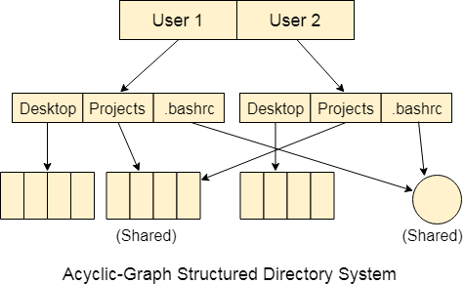

Slide 72
File system is the part of the operating system which is responsible for file management. It provides a mechanism to store the data and access to the file contents including data and programs. Some Operating systems treats everything as a file for example Ubuntu.
The File system takes care of the following issues
File Structure
We have seen various data structures in which the file can be stored. The task of the file system is to maintain an optimal file structure.
Recovering Free space
Whenever a file gets deleted from the hard disk, there is a free space created in the disk. There can be many such spaces which need to be recovered in order to reallocate them to other files.
disk space assignment to the files
The major concern about the file is deciding where to store the files on the hard disk. There are various disks scheduling algorithm which will be covered later in this tutorial.
tracking data location
A File may or may not be stored within only one block. It can be stored in the non contiguous blocks on the disk. We need to keep track of all the blocks on which the part of the files reside.

Slide 73
File System Structure
File System provide efficient access to the disk by allowing data to be stored, located and retrieved in a convenient way. A file System must be able to store the file, locate the file and retrieve the file. Most of the Operating Systems use layering approach for every task including file systems. Every layer of the file system is responsible for some activities. The image shown below, elaborates how the file system is divided in different layers, and also the functionality of each layer.

Slide 74
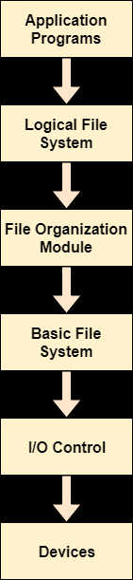

Slide 75
When an application program asks for a file, the first request is directed to the logical file system. The logical file system contains the Meta data of the file and directory structure. If the application program doesn't have the required permissions of the file then this layer will throw an error. Logical file systems also verify the path to the file.
Generally, files are divided into various logical blocks. Files are to be stored in the hard disk and to be retrieved from the hard disk. Hard disk is divided into various tracks and sectors. Therefore, in order to store and retrieve the files, the logical blocks need to be mapped to physical blocks. This mapping is done by File organization module. It is also responsible for free space management.
Once File organization module decided which physical block the application program needs, it passes this information to basic file system. The basic file system is responsible for issuing the commands to I/O control in order to fetch those blocks.
I/O controls contain the codes by using which it can access hard disk. These codes are known as device drivers. I/O controls are also responsible for handling interrupts.

Slide 76
File Allocation Methods
The allocation methods define how the files are stored in the disk blocks. There are three main disk space or file allocation methods.
Contiguous Allocation
Linked Allocation
Indexed Allocation
The main idea behind these methods is to provide:
Efficient disk space utilization.
Fast access to the file blocks.
All the three methods have their own advantages and disadvantages

Slide 77
1. Contiguous Allocation
In this scheme, each file occupies a contiguous set of blocks on the disk. For example, if a file requires n blocks and is given a block b as the starting location, then the blocks assigned to the file will be: b, b+1, b+2,……b+n-1. This means that given the starting block address and the length of the file (in terms of blocks required), we can determine the blocks occupied by the file. The directory entry for a file with contiguous allocation contains
Address of starting block
Length of the allocated portion.

Slide 78
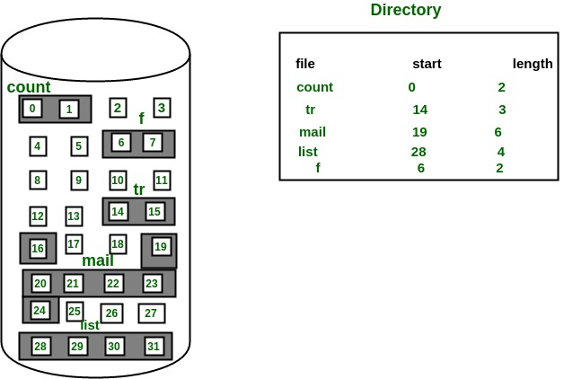
The file ‘mail’ in the following figure starts from the block 19 with length = 6 blocks. Therefore, it occupies 19, 20, 21, 22, 23, 24 blocks.

Slide 79
Advantages:
Both the Sequential and Direct Accesses are supported by this. For direct access, the address of the kth block of the file which starts at block b can easily be obtained as (b+k).
This is extremely fast since the number of seeks are minimal because of contiguous allocation of file blocks.
Disadvantages:
This method suffers from both internal and external fragmentation. This makes it inefficient in terms of memory utilization.
Increasing file size is difficult because it depends on the availability of contiguous memory at a particular instance.

Slide 80
2. Linked List Allocation
In this scheme, each file is a linked list of disk blocks which need not be contiguous. The disk blocks can be scattered anywhere on the disk. The directory entry contains a pointer to the starting and the ending file block. Each block contains a pointer to the next block occupied by the file.

Slide 81
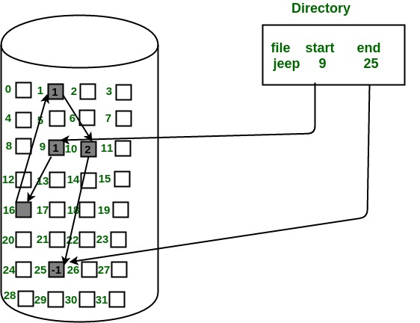
The file ‘jeep’ in following image shows how the blocks are randomly distributed. The last block (25) contains -1 indicating a null pointer and does not point to any other block.

Slide 82
Advantages:
This is very flexible in terms of file size. File size can be increased easily since the system does not have to look for a contiguous chunk of memory.
This method does not suffer from external fragmentation. This makes it relatively better in terms of memory utilization.
Disadvantages:
Because the file blocks are distributed randomly on the disk, a large number of seeks are needed to access every block individually. This makes linked allocation slower.
It does not support random or direct access. We can not directly access the blocks of a file. A block k of a file can be accessed by traversing k blocks sequentially (sequential access ) from the starting block of the file via block pointers.
Pointers required in the linked allocation incur some extra overhead.

Slide 83
3. Indexed Allocation
In this scheme, a special block known as the Index block contains the pointers to all the blocks occupied by a file. Each file has its own index block. The ith entry in the index block contains the disk address of the ith file block. The directory entry contains the address of the index block as shown in the image:

Slide 84
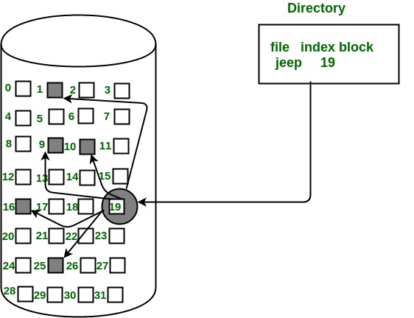

Slide 85
Advantages:
This supports direct access to the blocks occupied by the file and therefore provides fast access to the file blocks.
It overcomes the problem of external fragmentation.
Disadvantages:
The pointer overhead for indexed allocation is greater than linked allocation.
For very small files, say files that expand only 2-3 blocks, the indexed allocation would keep one entire block (index block) for the pointers which is inefficient in terms of memory utilization. However, in linked allocation we lose the space of only 1 pointer per block.

